Slide 1

Thames river anglers Association

Slide 2
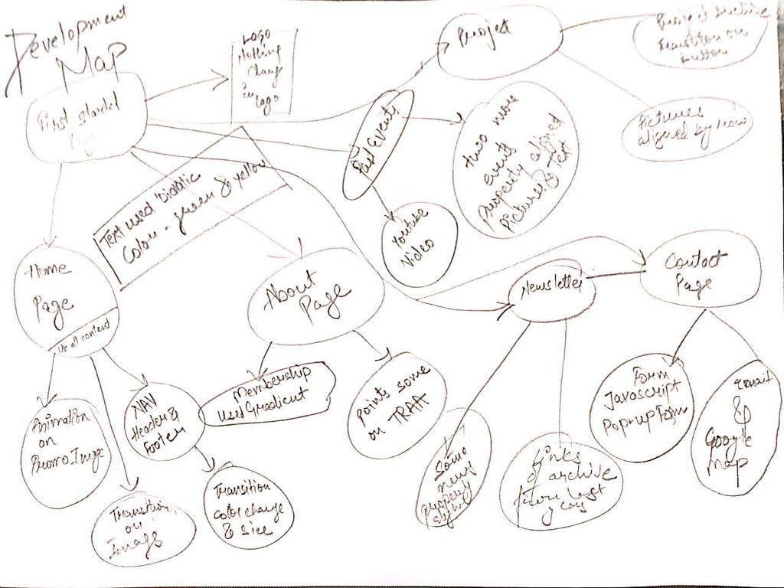
Planning
Development Map

Slide 3

Resources
Internet, Anglers.org
Grab the info from original site and try to manipulate it.

Slide 4
Animations
Try to do animation on text and menu.
Did animation on contact form.

Slide 5



Mockups

